Slide 1
IEA Wind Task 52 – Wind Lidar Ontology Group
Task 52 General Meeting 2023
WG7 presentation
Francisco Costa
@University of Stuttgart - SWE
Online
13 June 2023
Notes:
I want to give an update on the tasks carried out by the Wind lidar ontology group members these last months, what are we up to nowadays and what the group‘s plans are for the near future.

Slide 2
WG7 – Wind Lidar Ontology Group
The team
Aidan Keane – Renewable energy consultant @wood – aidan.keane@woodplc.com
Andy Clifton – Andy @Enviconnect – andy.clifton@enviconnect.de
Ashim Giyanani – @Fraunhofer – ashim.giyanani@iwes.fraunhofer.de
Carlo Alberto Ratti – Wind Farm Analyst @Enlight – carloar@enlightenergy.eu
Dexing Liu – Associate researcher @University of Stuttgart – SWE – liu@IFB.Uni-Stuttgart.de
Francisco Costa – PhD student @University of Stuttgart – SWE – costa@ifb.uni-stuttgart.de
Notes:
The team is a multidisciplinary team including folks from academia and industry.
Aidan keane based in Scotland and working for wood. Present in many parts of the world wood covers a wide range of activities, among which are renewables.
Andy Clifton, now freelancer and Business manager in enviconnect → wind lidar consultancy service
Carlo Alberto Ratti also from industry working at enlightenergy, a renewable energy platform delivering solar, wind and storage projects at scale.
Halfway between industry and academia we have Ashim Giyanani from Fraunhofer Institute
Dexing and I are colleagues at SWE, focused on wind energy research.
This is the current Ontology Group, but others others have contributed as much or even more to this work, People like Peter Clive, Nikola Vasiljevic or the FAIR data Collective need to be acknowledge here as well.
Now, for those wondering, what are these people doing or how can this help the lidar community? , a quick review of the group's objectives might help in answering these questions.

Slide 3
WG7 – Wind Lidar Ontology Group
Objectives
Develop a formal, clear and dedicated controlled vocabulary for lidar terms
Convert lidar knowledge into FAIR (Findable, Accessible, Interoperable and Reusable) lidar knowledge
Long term updates and maintenance of the ontology
Notes:
The main goal is to support the lidar community. We know that a lidar community already exists (we build it everyday!), but it is made up of many parts that speak different jargons and use different terms for lidar concepts. Therefore, tools like the Lidar Ontology can help bring these parts together. And we believe that simply agreeing on a single lidar language can greatly benefit this process.
With this in mind, the following points may help with this.
Develop a formal, clear and dedicated controlled vocabulary for lidar terms as this will help because to creat al community the very first thing we need is to speak the same language. That said, in the context of lidar would be useful to come up with a shared lidar language to help transfer data and knowledge. That‘s where ontologies come in
Convert lidar knowledge into Fair lidar knowledge. This will encourage collaboration and information exchange among researches and among institutions either from industry or academy. Also, facilitates participation of new entrants and dissemination among non-experts in lidar
Ideally, the version is under continuous update. Due to evolution of new lidar applications and technology, frequent addition and edition of terms will be needed

Slide 4
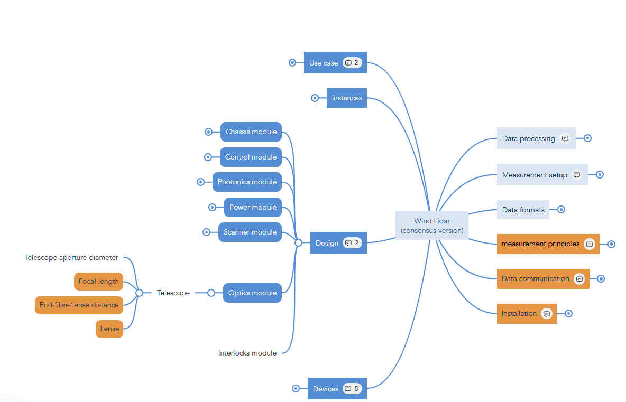

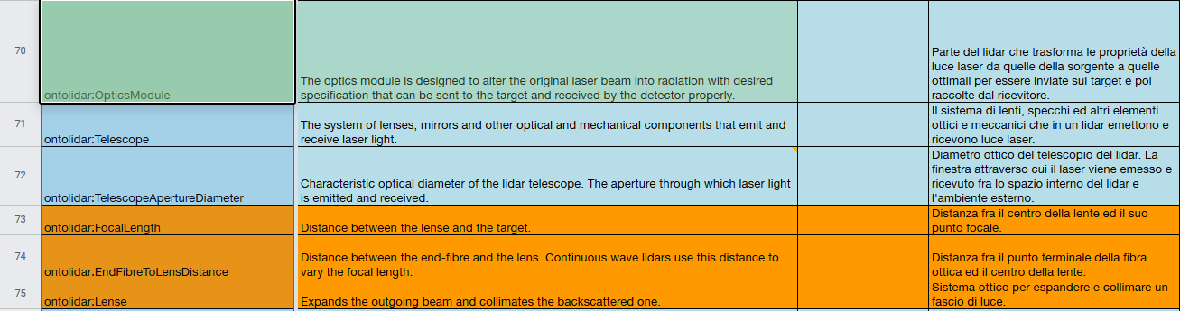
WG7 – Wind Lidar Ontology Group
The plan
Create a working group
The Mind map → Taxonomy
Define lidar concepts
Deploy lidar ontology
Definitions
Notes:
Create a woking group as the one presented
First step was to come up with a list of most relevant lidar terms and arrange them following transitive and parent-child relationships thus, defining an orderly classification for the defined domain or taxonomy
Lidar concepts definition. Concepts were assigned according to authors’ expertise to be elaborated and the results of their implementations were exposed, discussed and agreed upon by the members of the ontology group in recurrently scheduled meetings.
Deployment of the lidar ontology. The ontology homepage contains information about the title of the ontology, a short description of the lidar ontology website and resource counts by type. Hosting for the online deployment is provided by the Technical University of Denmark (DTU) as an ontostack instance in the form of a human-friendly look-up table.

Slide 5
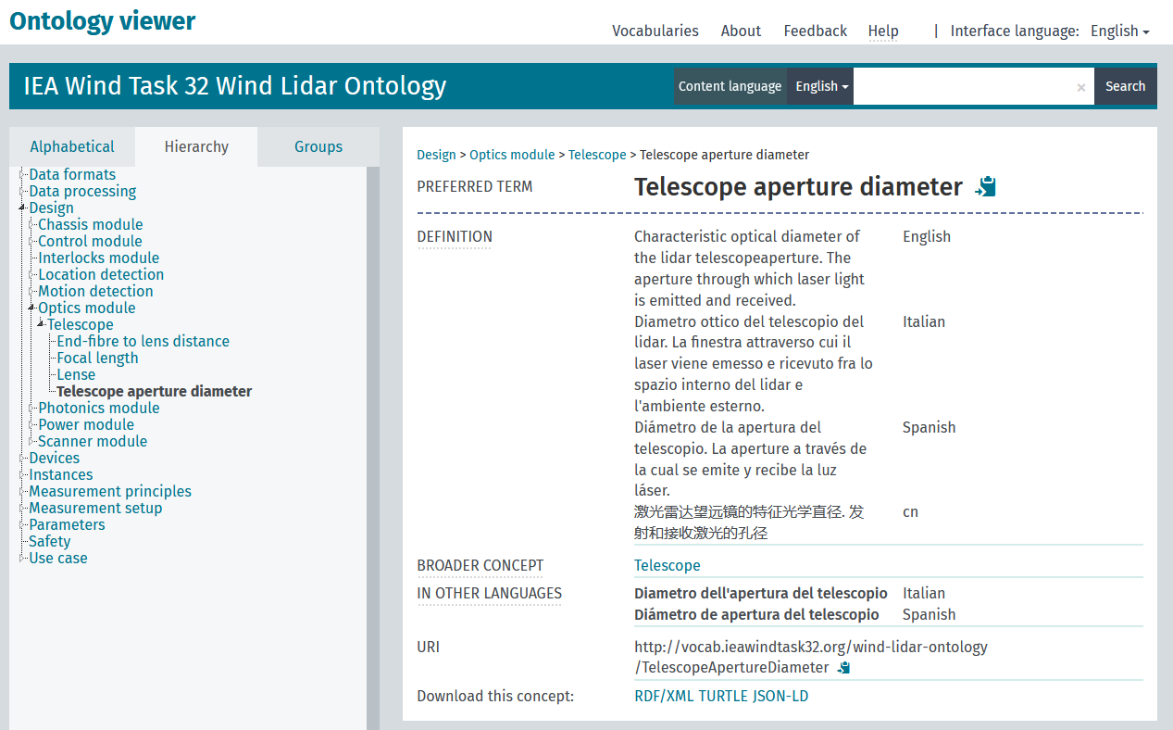
WG7 – Wind Lidar Ontology Group
The Lidar Ontology
Notes:
The human-friendly version of this interactive look-up table can be found at \cite{}.

Slide 6

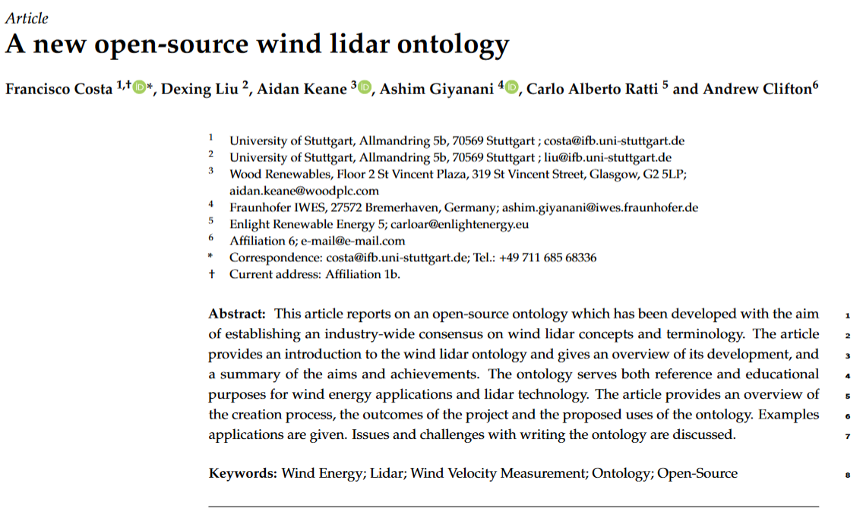
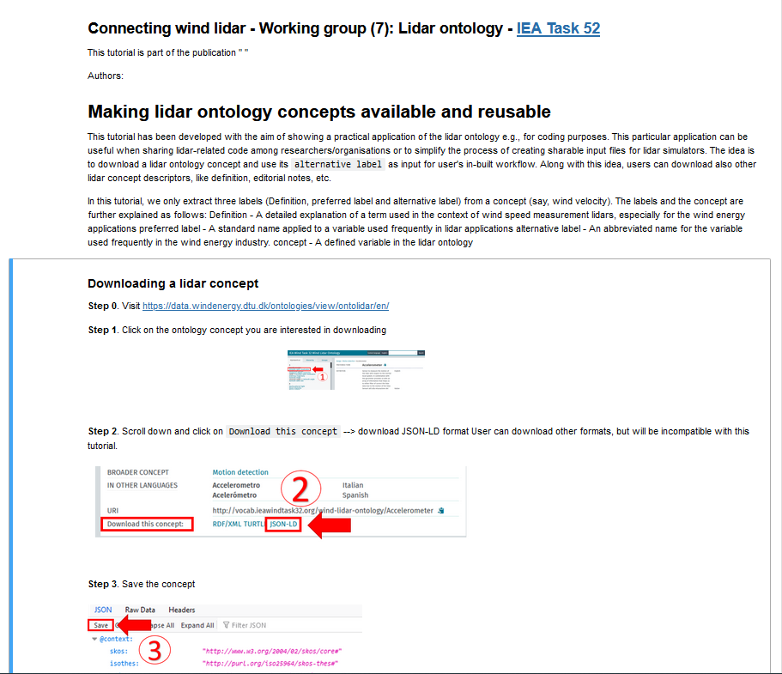
WG7 – Wind Lidar Ontology Group
Deliverables
Notes:
Concerning deliverables
We are about to submit an article where we explain the work done so far and moreover most interestingly, we present an Ontology use case through a Jupyter notebook. In this Jupyter notebook we explain how to:
Download a lidar concept from the ontology viewer
Extract the desired data from the downloaded data
And an application case
Jupyter notebook – We want to present it in a WEBINAR!

Slide 7
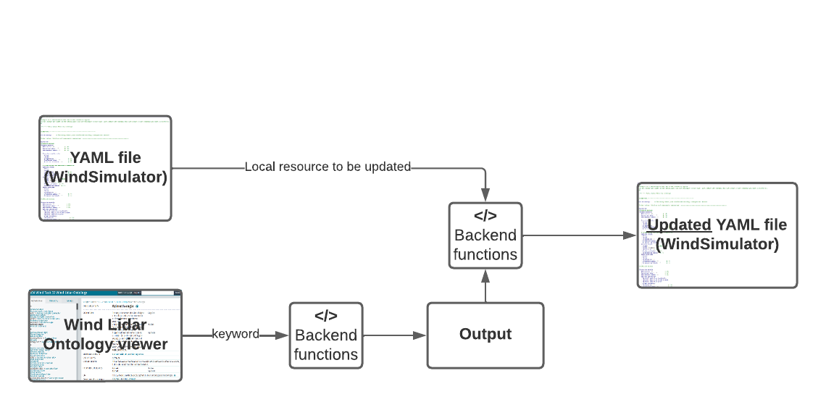
Jupyter notebook
The application: Wind simulator
Notes:
In the Jupyter notebook we illustrate an application on how to facilitate the aquisition of information from the ontology viewer and use it for further purposes, in this case for updating a YAML file used as a template for a lidar simulator. The workflow

Slide 8
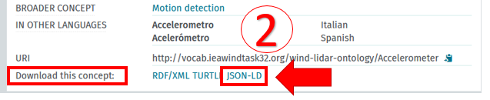
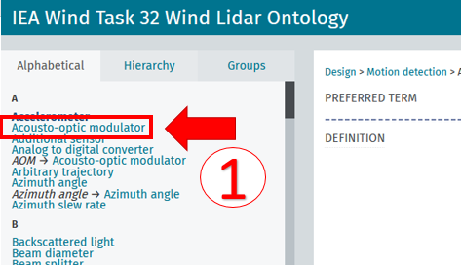
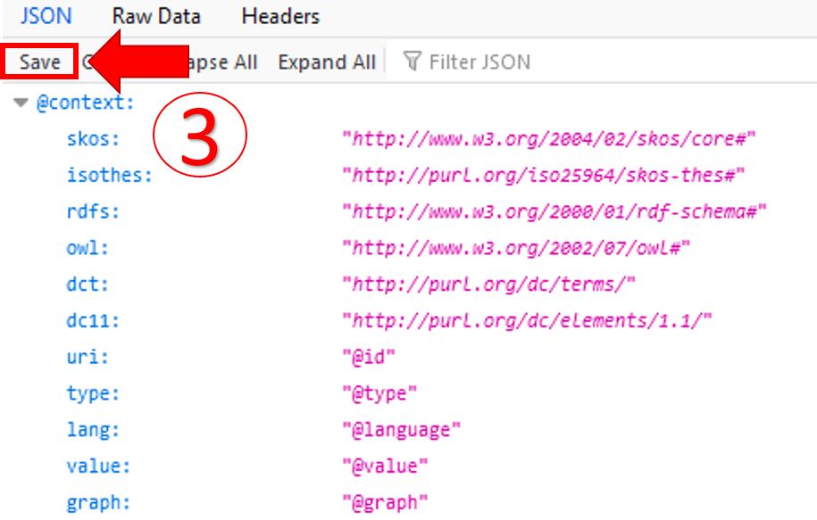
Jupyter notebook
The inputs
Visit https://data.windenergy.dtu.dk/ontologies/view/ontolidar/en/

Slide 9
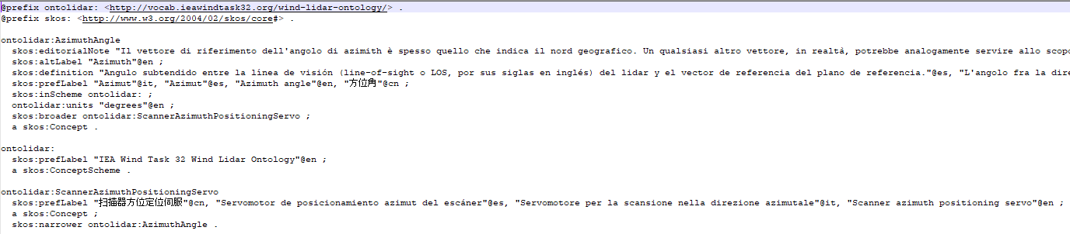
Jupyter notebook
Jupyter notebook
The output

Slide 10
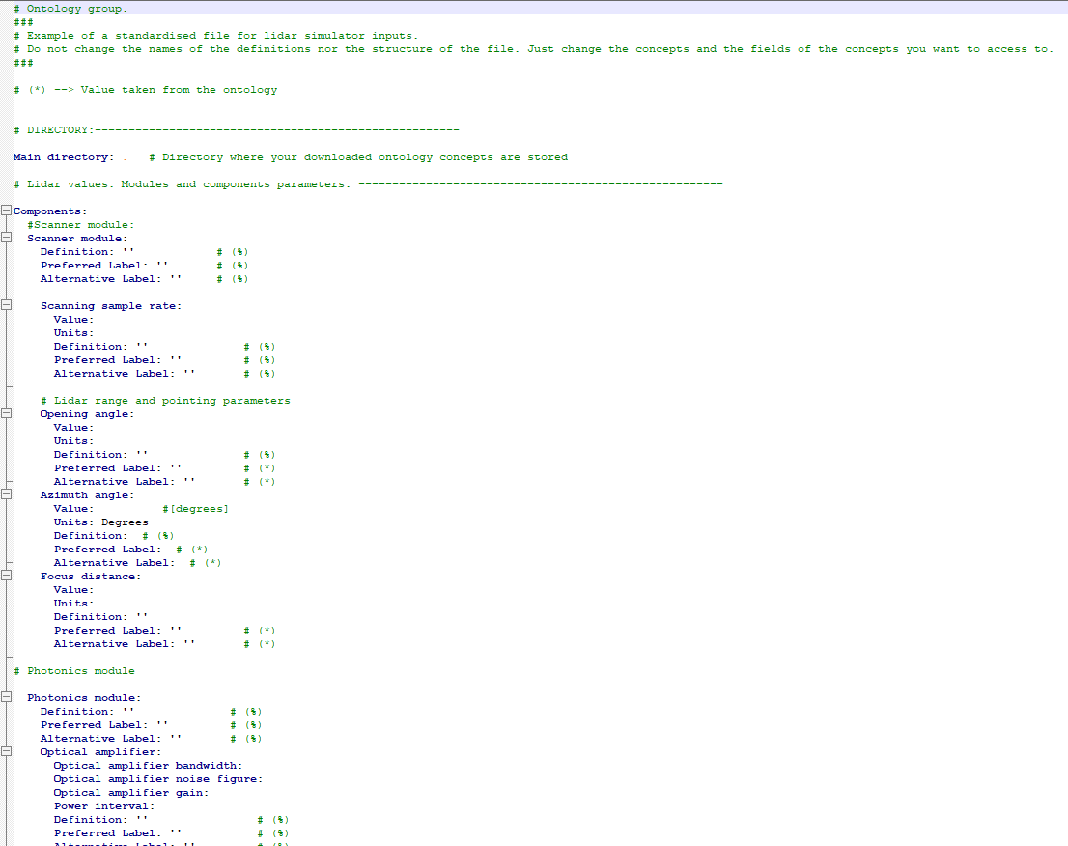
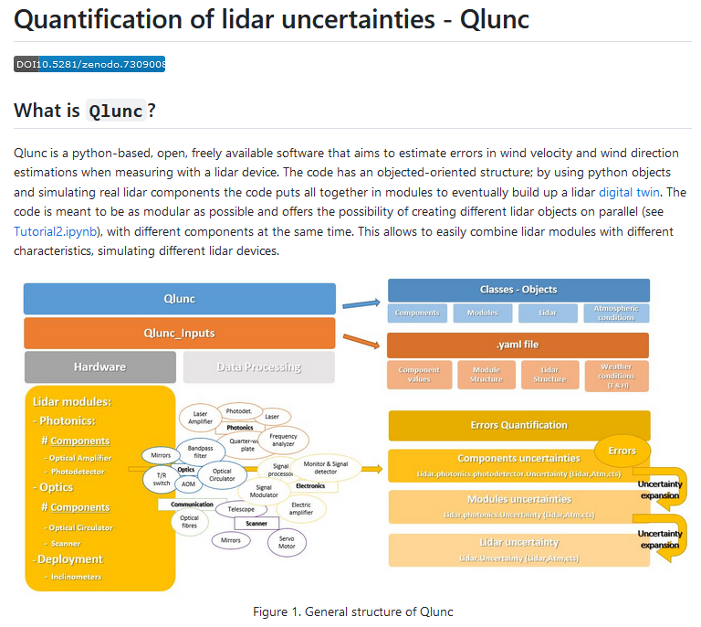
Jupyter notebook
The application: Wind simulator
Notes:
With this ontology we make available a common CV that unambiguously defines the many aspects of a wind lidar. The ontology can be used to help transfer data, tools, and knowledge. With the Jupyter notebook we aim to illustrate how the ontology can be used, for example, to simplify the process of creating input files for simulations.

Slide 11
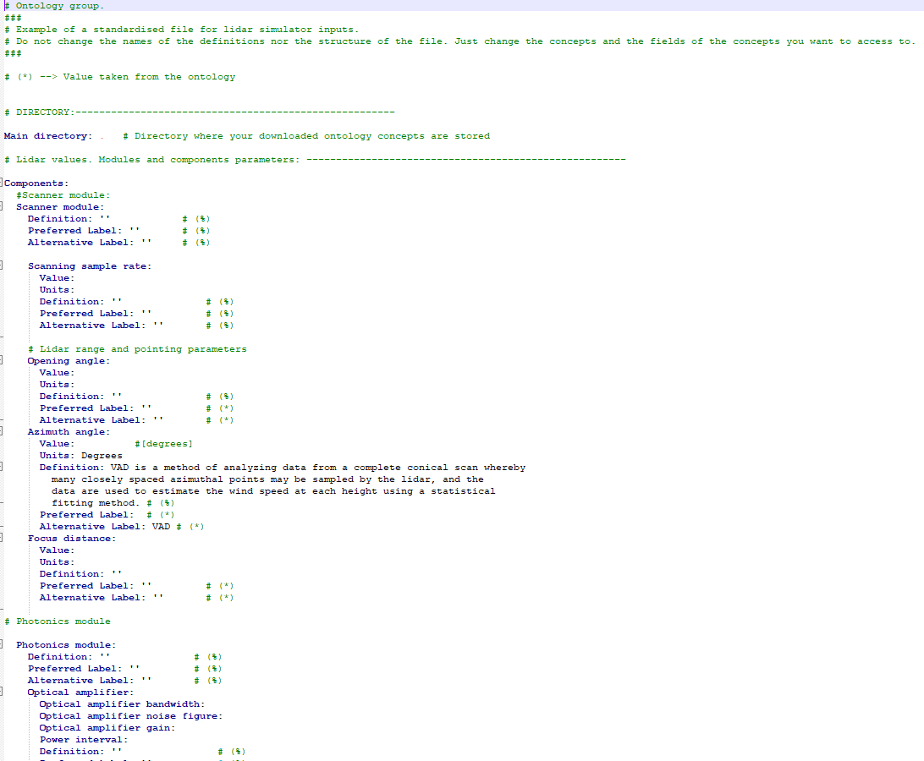
Jupyter notebook
The application: Wind simulator

Slide 12






WG7 – Wind Lidar Ontology Group
Supporting large-scale wind lidar deployment
Design and use
Task-specific optimization
Lidar assisted wind turbine control
Pre- and post- campaign preparation
Market acceptance
DevOps
Fonts: iStock, Wikimedia Commons, ASP, Freeiconspng, CleanLink and EuroLab, Accessed: 04/0.8.06.2023
Notes:
To end with:
Manufacture
Deployment, operation and test
Maintenance
Speed up data analysis
Lidar task-specific optimization
Lidar assisted wind turbine control
Pre- and post- campaign preparation
Market acceptance
IEC standards
Safety protocols
Avoid lidar black boxes
Reduce the possibilities for innovation
Sharing data and resources (code or template for a lidar simulator)
Safety : Lidar safety class for public purposes
IEC definitions

Slide 13
WG – Wind Lidar Ontology Group
Help us to build this!
C. Ratti – carloar@enlightenergy.eu
D. Liu – liu@ifb.uni-stuttgart.de
A. Clifton – andy.clifton@enviconnect.de
A. Keane – aidan.keane@woodplc.com
A. Giyanani – ashim.giyanani@iwes.fraunhofer.de
F. Costa – costa@ifb.uni-stuttgart.de
IEA Wind Task 52 Wind Lidar Ontology

Slide 14
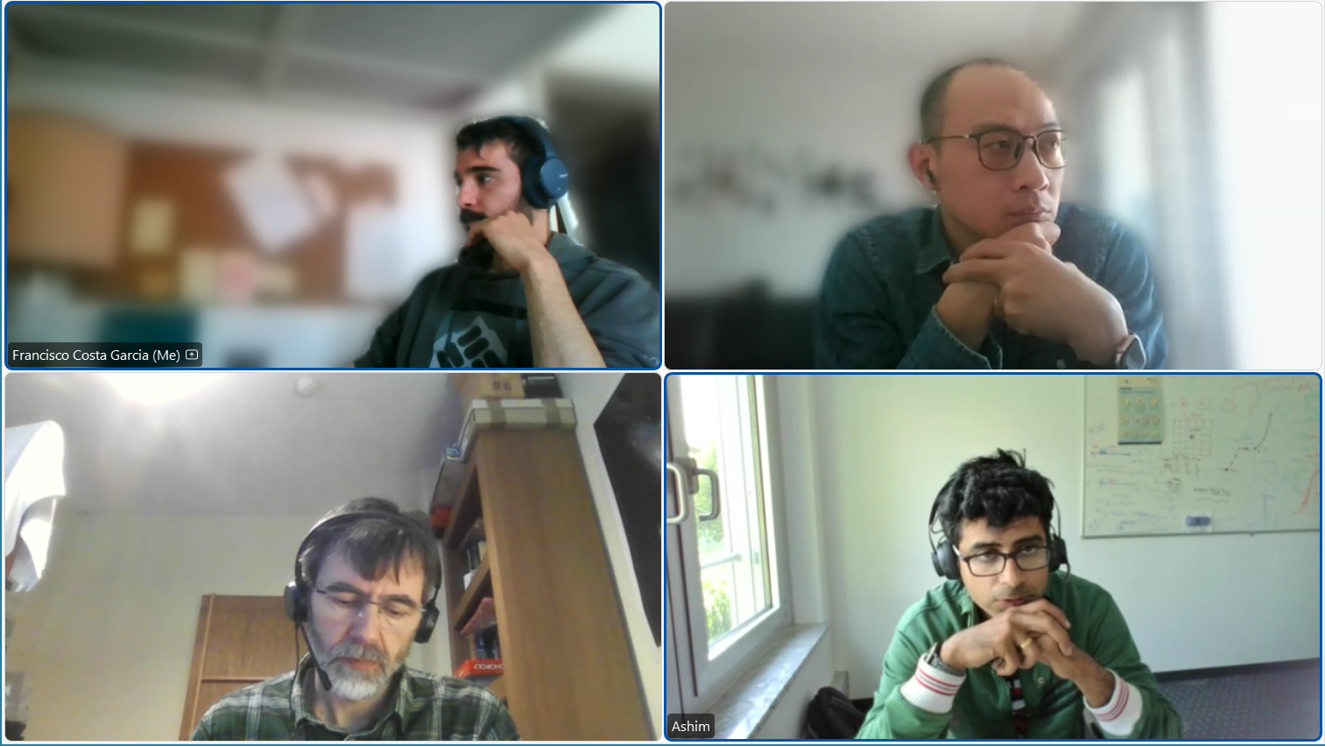
WG7 – Wind Lidar Ontology Group
Bi-weekly meetings

